Slide 1
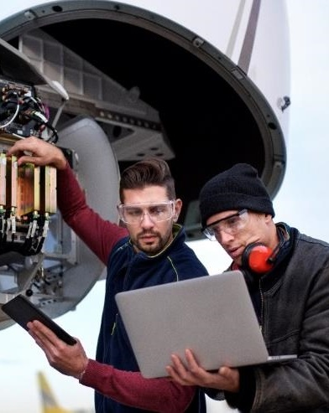
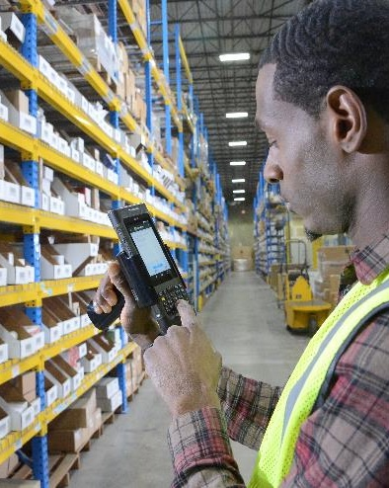
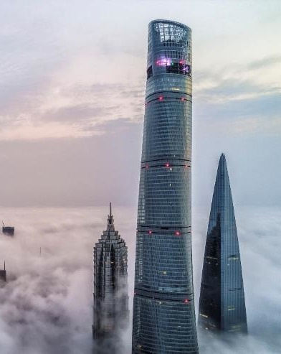
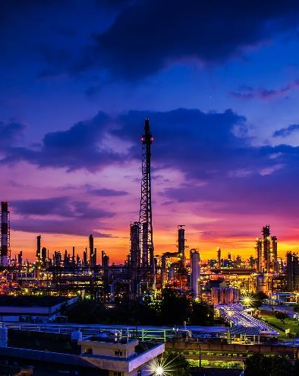

Suncor DASHBOARDS
John GOODMAN
Sunil Pachpande

Slide 2
INSIGHTS

Slide 3
Suncor AcceSsible Dashboards Links

Slide 4
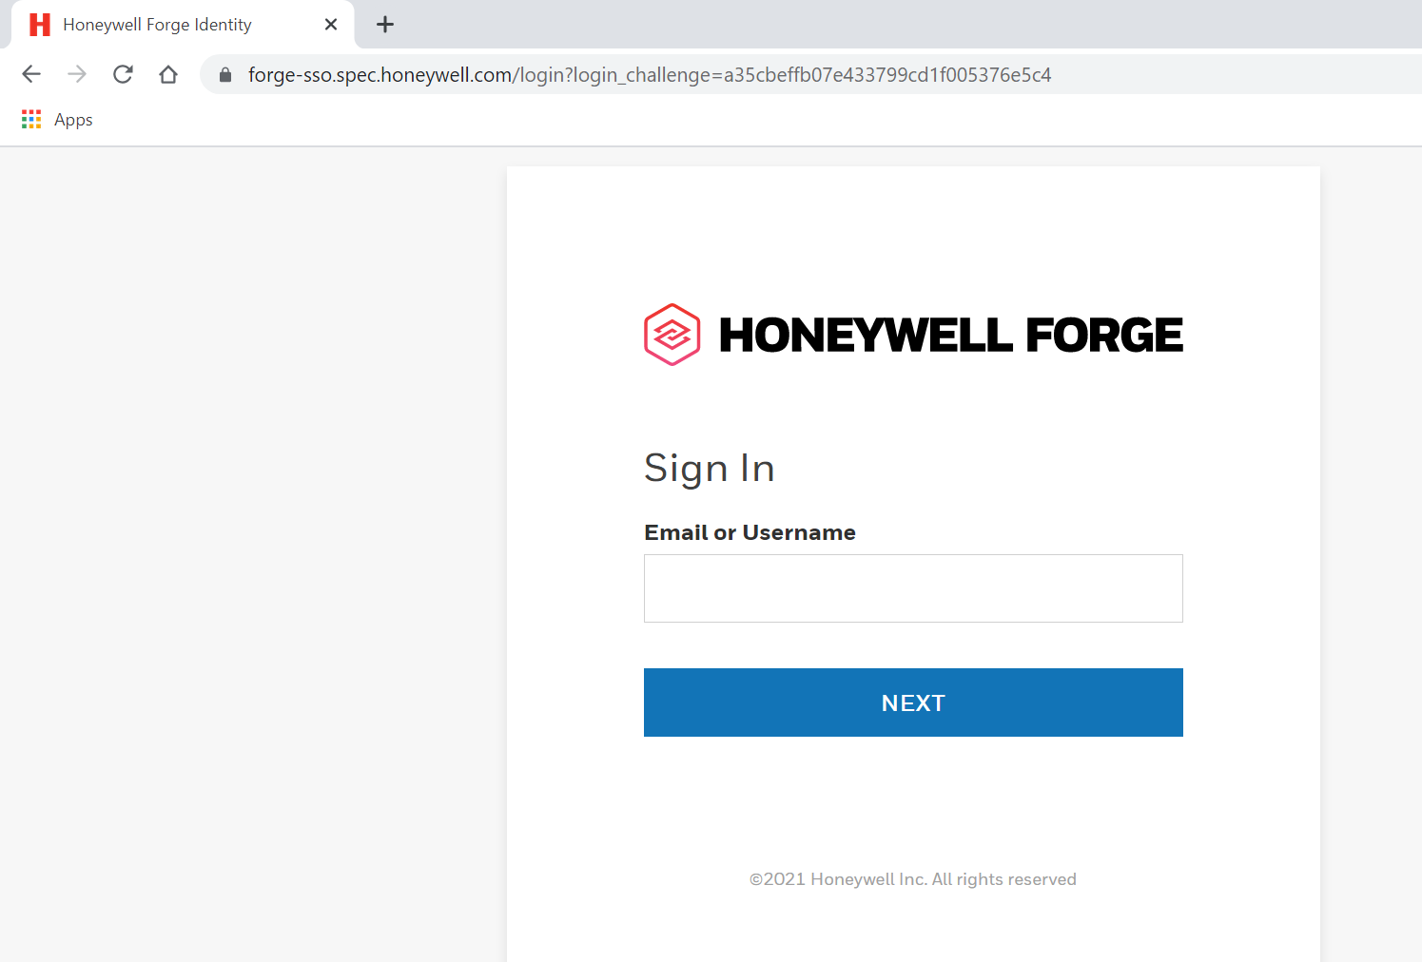
Below details take you from the initial login, to accessing the dashboards
Link to access the dashboard for Login - Dashboard link
Enter your Credentials
Remember your Credentials

Slide 5
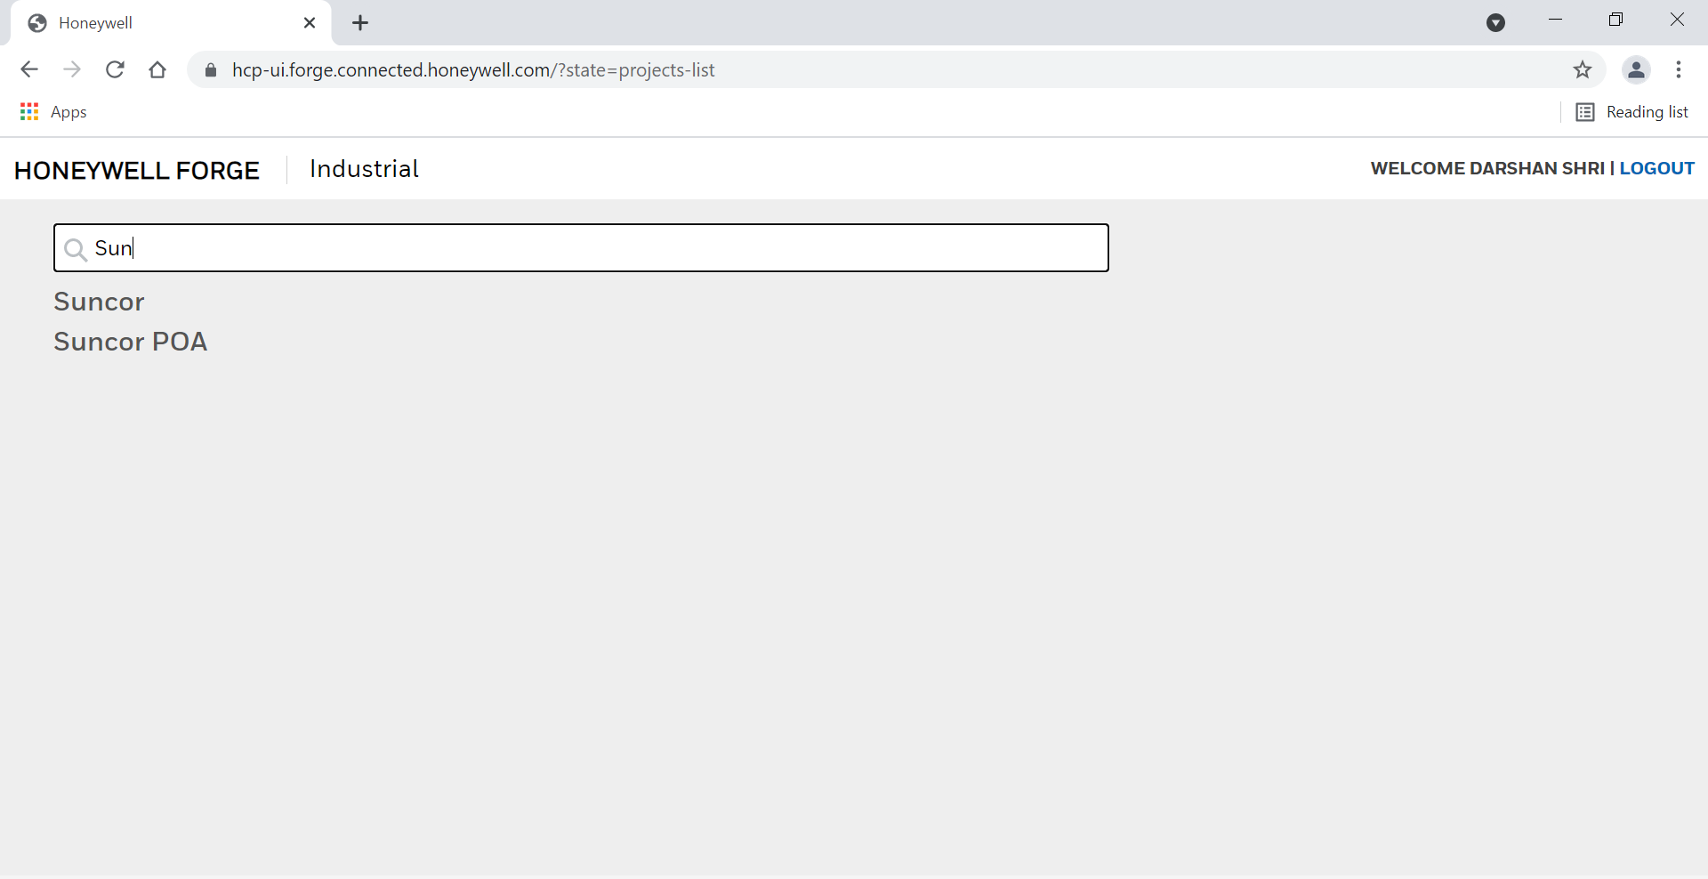
User Name of the person who has logged in
Select Suncor from the below list

Slide 6
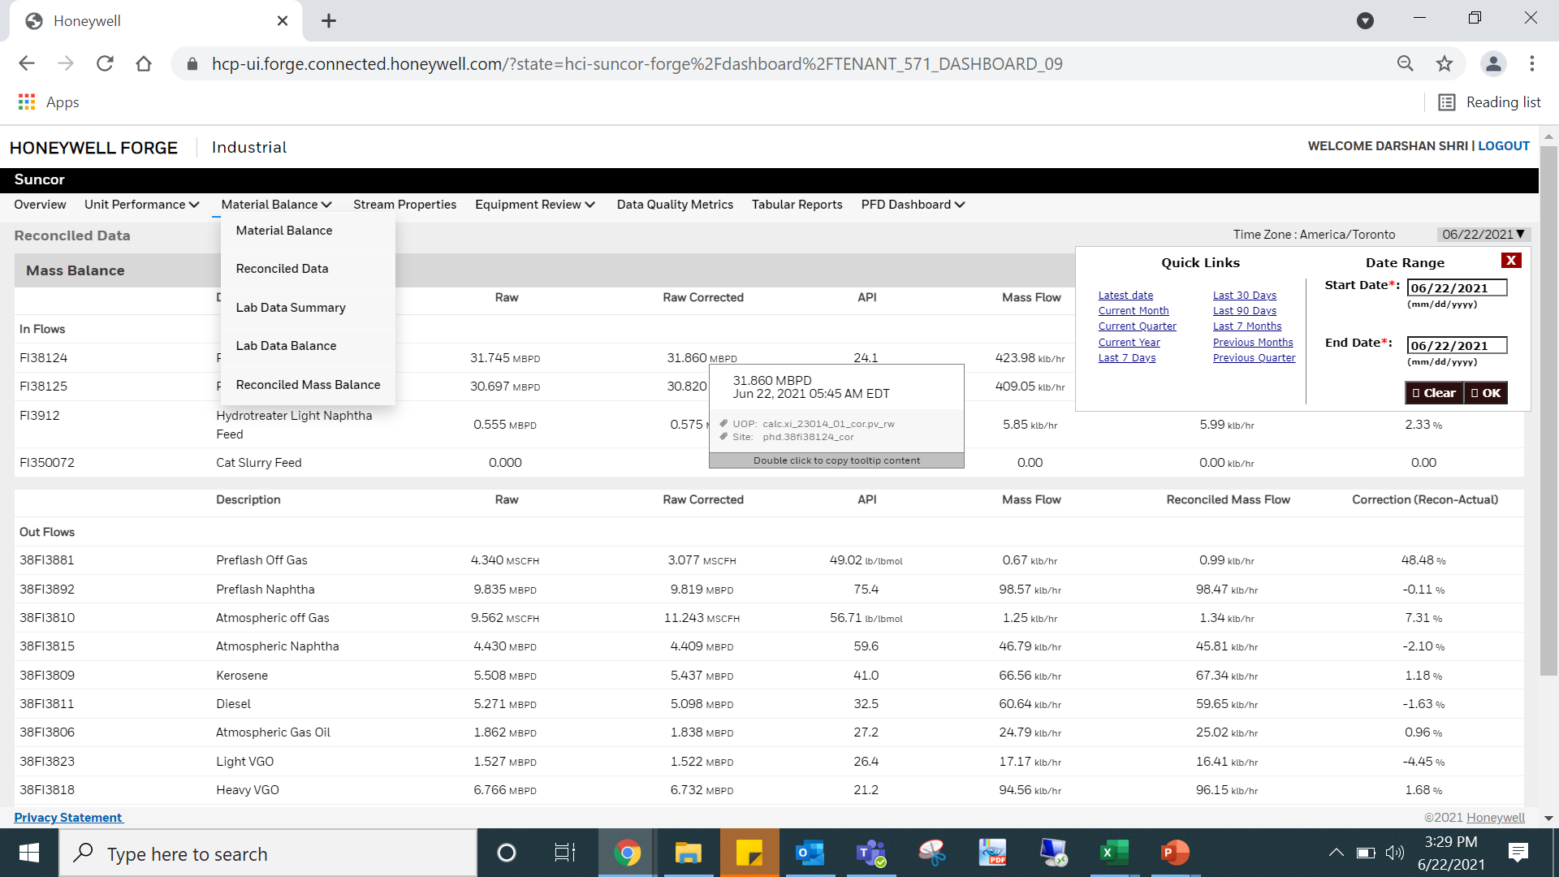
Overview of a dashboard screen - Reconciled Data
Individual Screen Heading
Suncor can access all the screens present in display bar
From the drop- down arrow navigate to individual screens if present

Slide 7
Overview of a dashboard screen
For easy navigation:
Quick Links to time stamp are present in the list
Tag details:
Time stamp
Site (Suncor) tag
UOP Tag
UOM

Slide 8
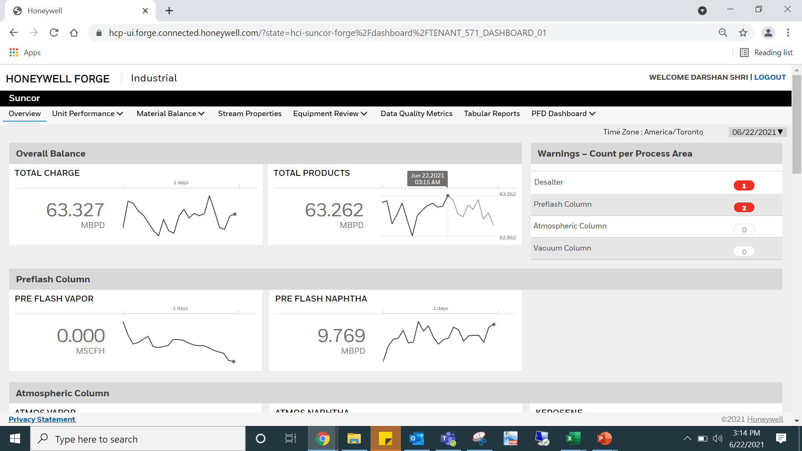
Types of different widget present on dashboards - Overview
Warnings for action panel will display in red.
Time Stamp
Value with a graphical trend
Average high and low value for a particular time period

Slide 9
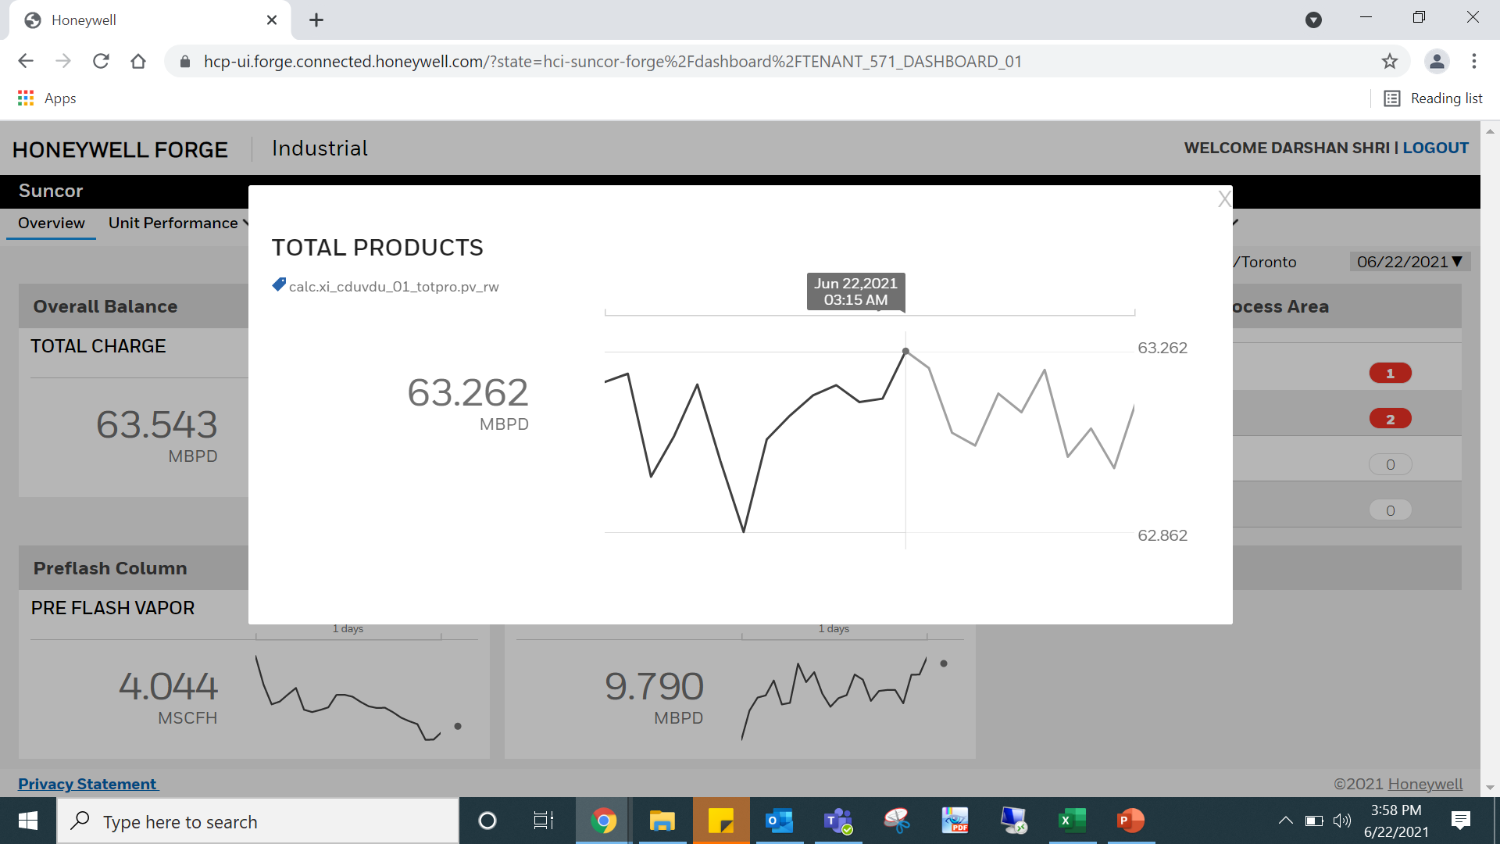
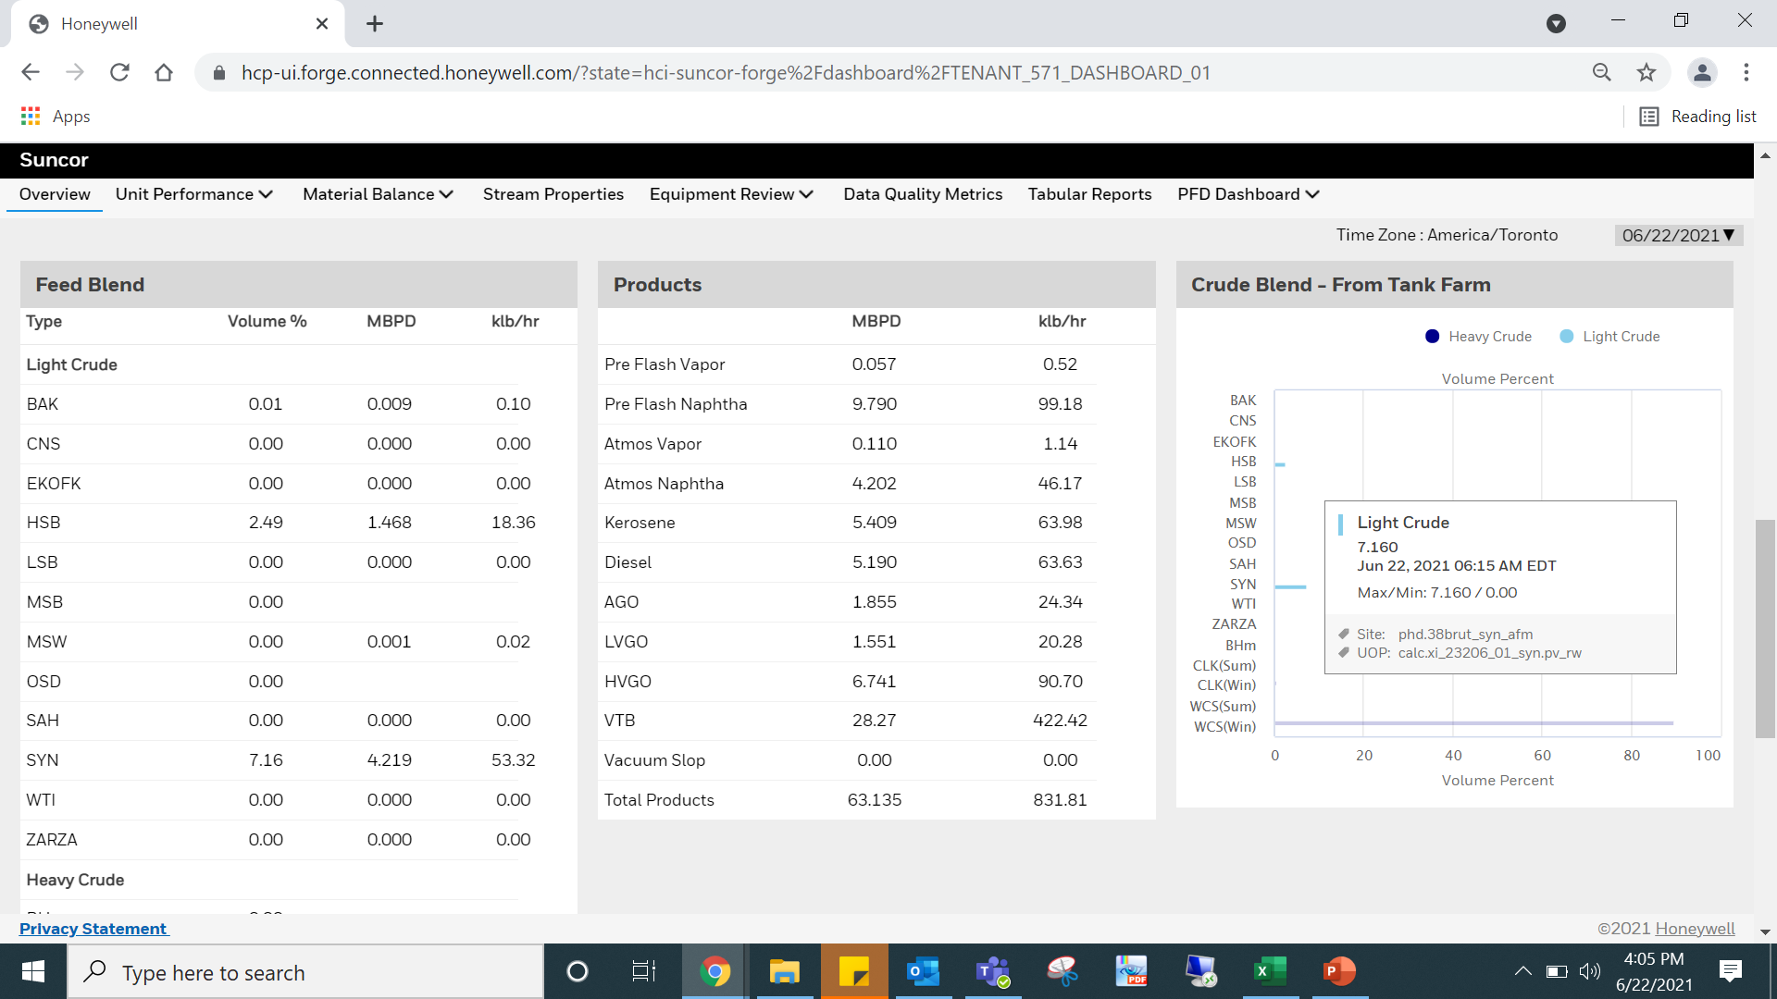
Types of different widget present on dashboards
Click on trends a pop-out window will appear with details of tag (Site/UOP)
Bar chart easy identification of light/heavy crude
Box contains all the details including tag name (Site & UOP) ,Time stamp
Pointer Contains Time stamp,Tag name & UOM

Slide 10
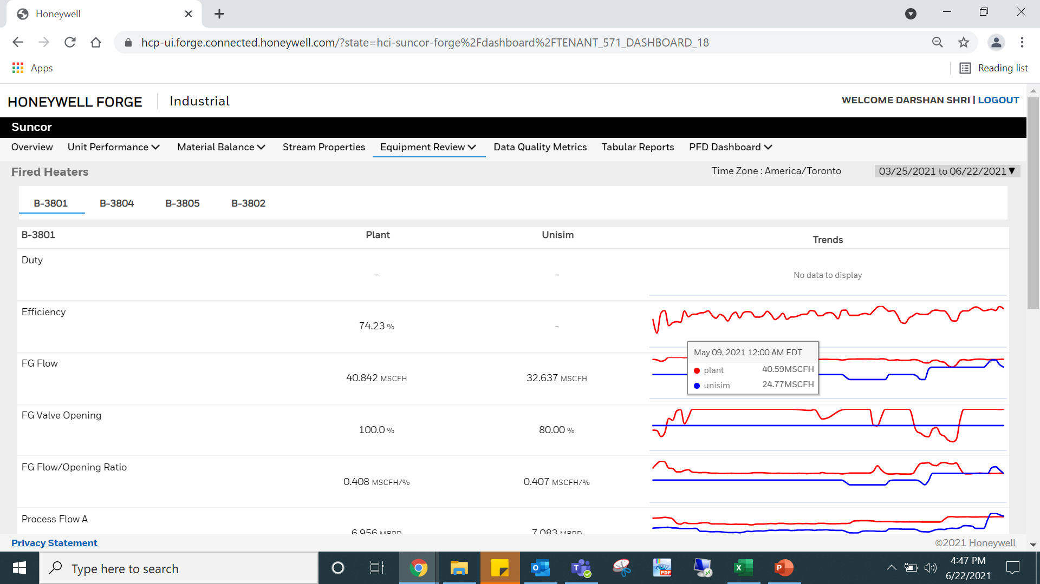
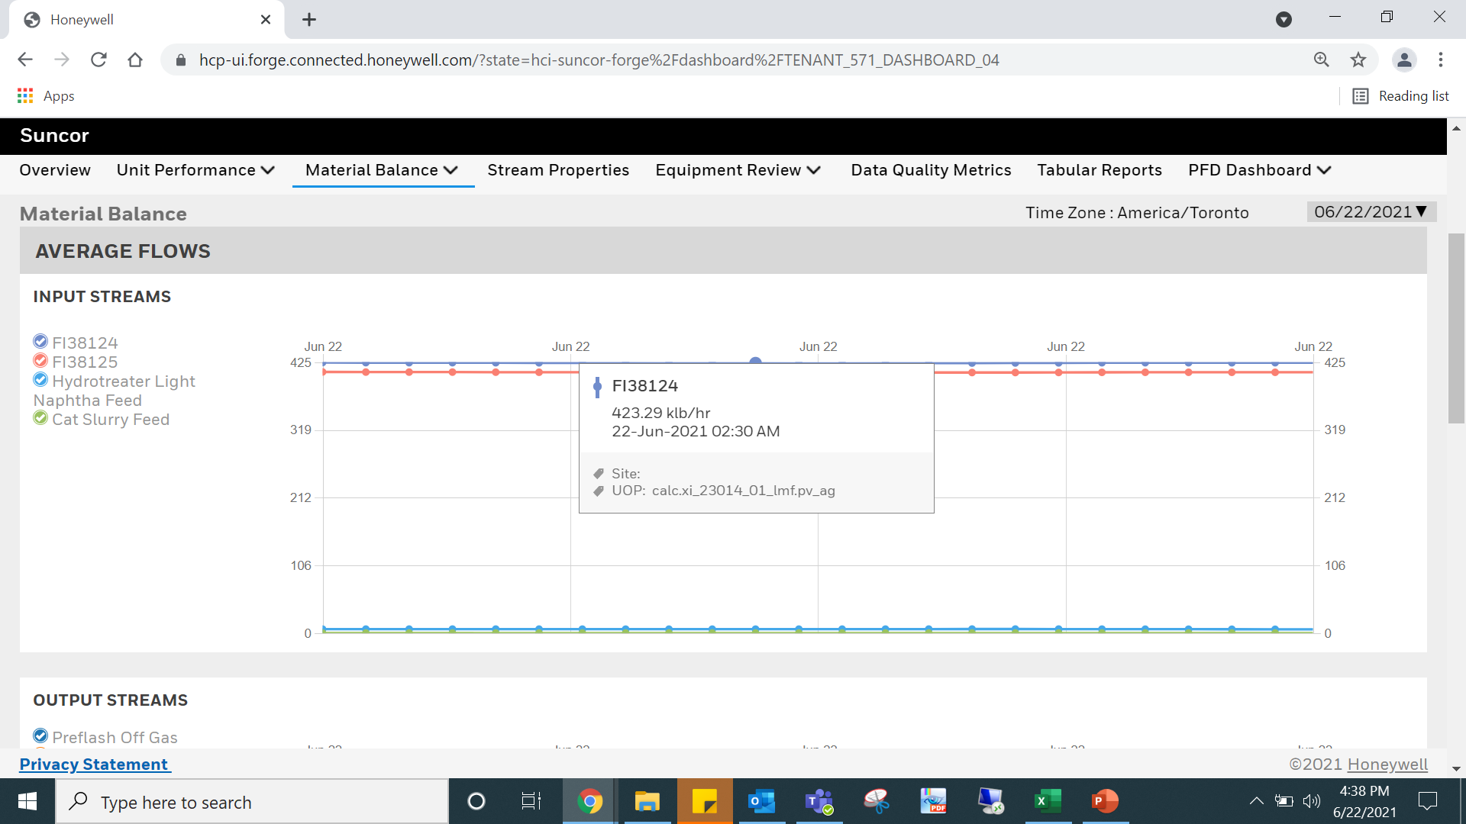
Types of different widget present on dashboards - Material Balance & Fired Heaters
Move to individual section by clicking on the heading
List of tags to be displayed as graphs
Can also be viewed individually by unchecking the circle
Details of trend:
Plant & Unisim - tag color and value
Time Stamp

Slide 11
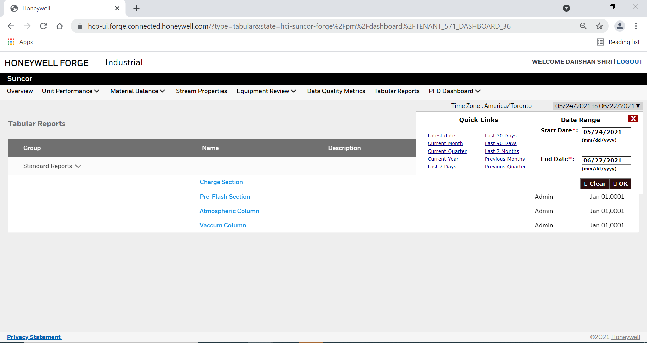
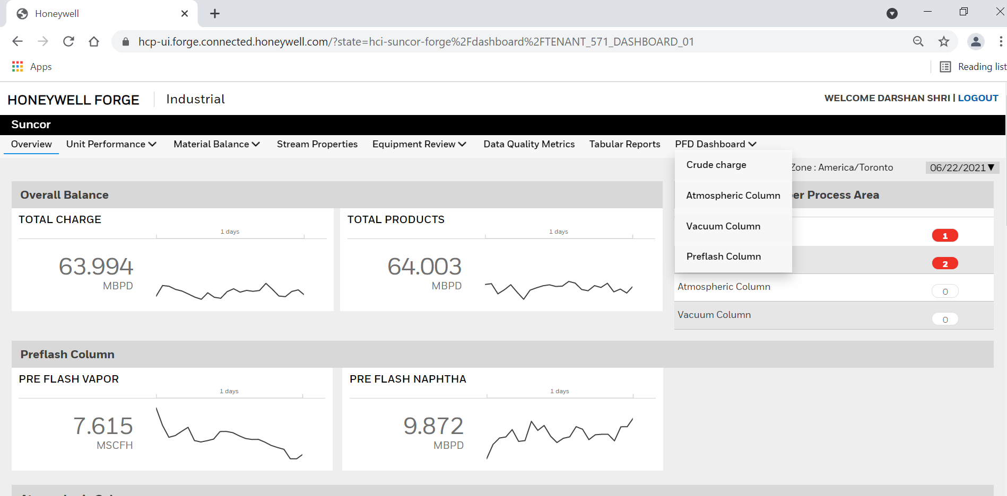
Types of different widget present on dashboards – Tabular Reports
For PFD Dashboard select the desired section from the drop down
One must have active connected plant login to access these dashboards
All 4 sections data can be exported in excel from these tabular reports
Time range can be selected from this section as discussed in above slides

Slide 12
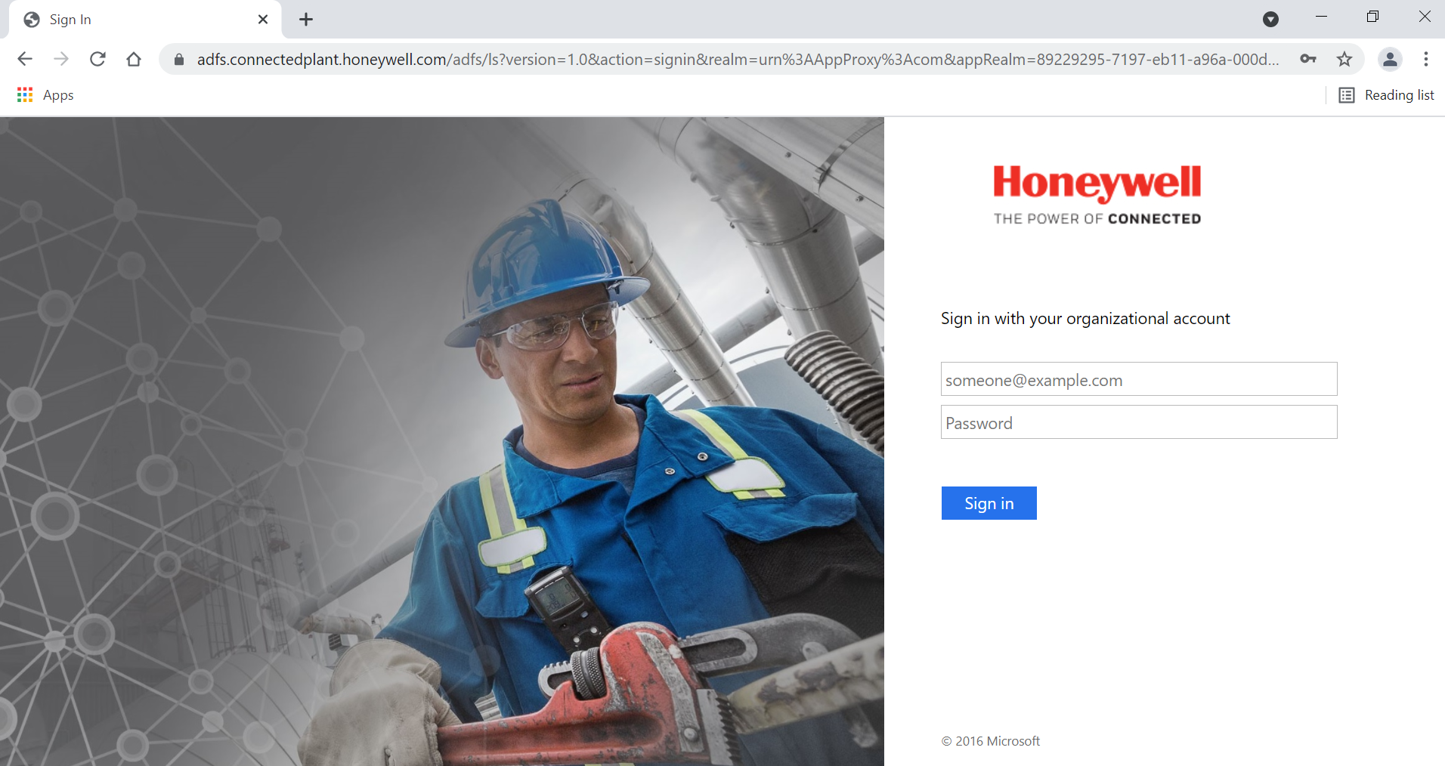
For connected plant login
Link for connected plant - Connected Plant Login
Enter your Connected Plant Credentials
Remember Connected Plant Username & Password

Slide 13
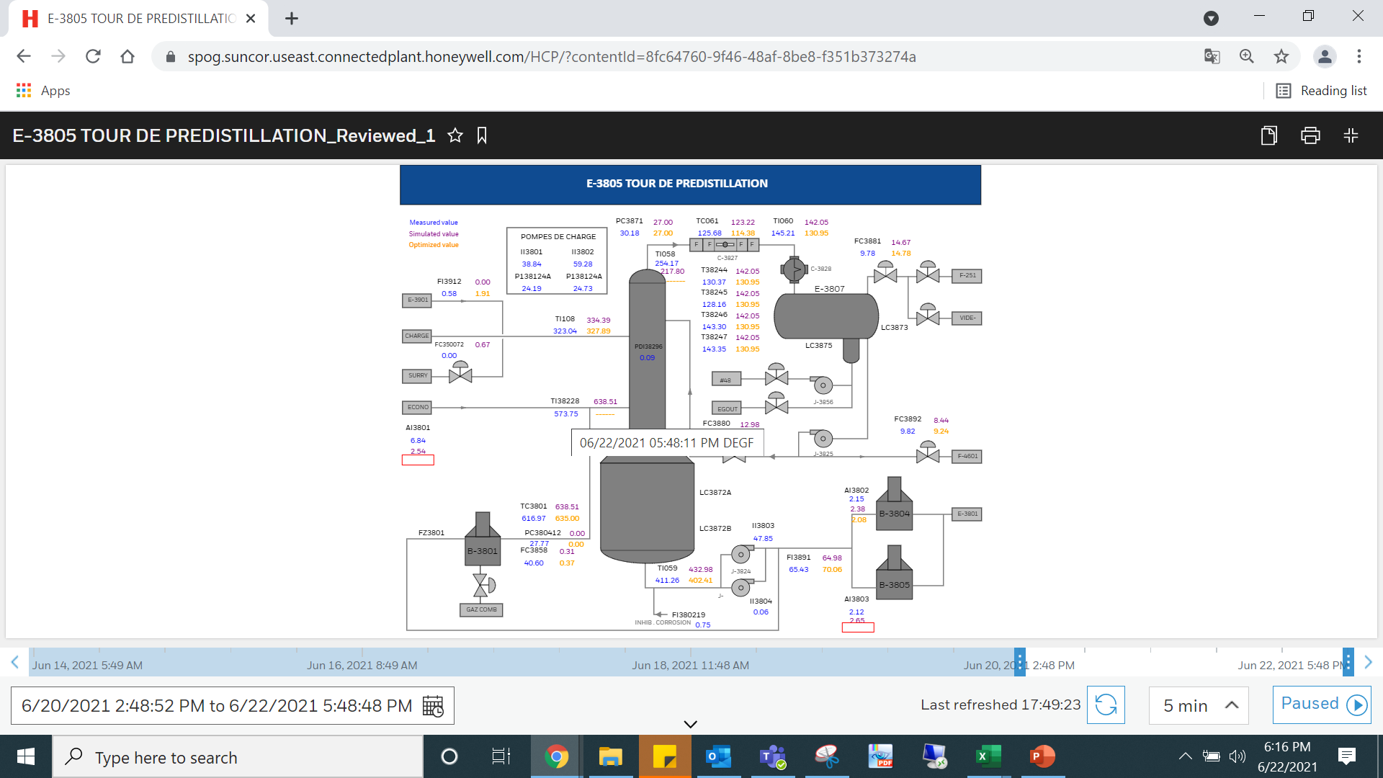
PFD Dashboards – Pre-flash Screen
Tags are represented as different colors
Each value has time stamp details
Custom Time stamp selection

Slide 14
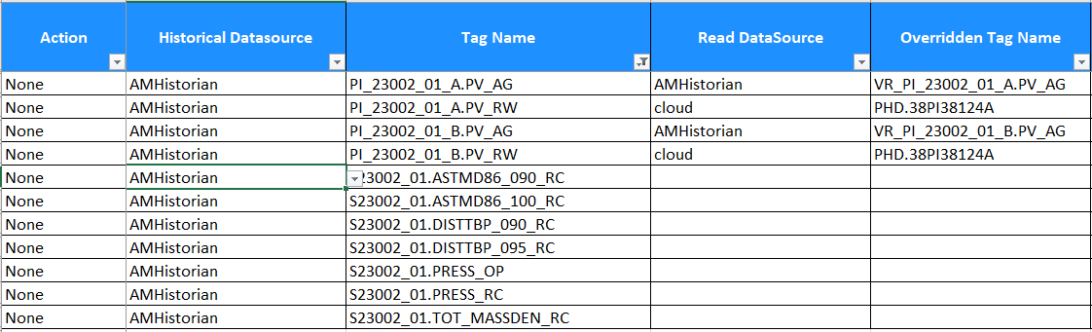
Mapping to Asset.attributes in embedded PHD

Slide 15
Aggregation
Aggregation is done on last 120 minutes data

Slide 16
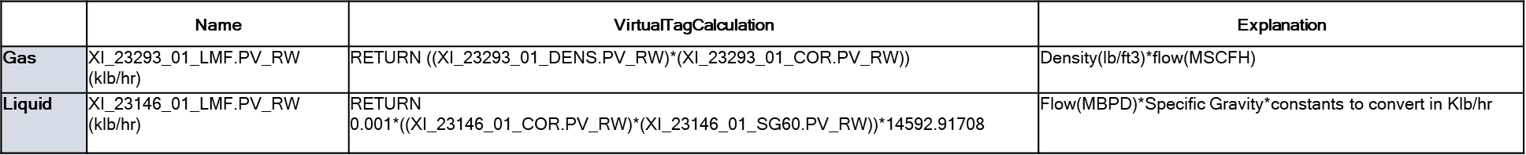
Conversion to mass
Volume corrected flows are used for mass conversion

Slide 17
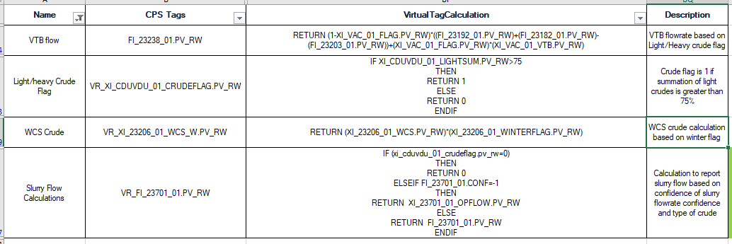
Other checks – Slurry calcs, VTB calcs, Summer/Winter calcs

Slide 18
Local historization
CPS tags are historized in AMHistorian(e-PHD)

Slide 19
GED

Slide 20
Preprocessing calculations SSD
Writing the Individual & Overall SSD Flag
Overall SSD Flag as MR Code Trigger Switch
Run SSD Code
Generating the Output -SSD FlagS
Fetching of the Values of SSD Tags from e-PHD
Scheduling of the SSD Algorithm-Windows Scheduler
e-PHD
SSD Code - Python/Power shell
Frequency of SSD code execution is 30 min

Slide 21
Preprocessing calculations SSD
List of identified Tags re-presenting Steady State
Overall SSD Flag=XI_CDUVDU_RECONMB_01.CL_ECPR
Pre-Condition for MR code Execution-Overall SSD Flag >0.8
Frequency of Execution-30 min
Frequency of SSD code execution is 30 min
20

Slide 22
Mass Reconciliation
e-PHD
Writing GED & Recon Values to
e-PHD
Run MR Code
Generating the Recon Output & GED
Fetching of the STDEV & AVG Values of MR Input Tags
Scheduling of the MR Algorithm-Windows Scheduler
Pre-Condition Check
MR Code - Python/Power shell
Frequency of MR code execution is 30 min

Slide 23
Preprocessing calculations- MR
List of identified Input Tags for MR Code
Recon Mass Balance Tag=VR_XI_CDUVDU_01_RCNMBFLAG.PV_RW
Pre-Condition for MR code Execution-Overall SSD Flag >0.8
Frequency of Execution-30 min
Frequency of SSD code execution is 30 min

Slide 24
Orchestration step-1 (reading data)
Increment Schedule for next Run
Kill Unisim Process if KeepProcess False
Run Solver
Generation of Output Snapshot .csv & .usp
Fetching of the Values Input Values for USD Input PDT
Scheduling of the Orchestration Service
Ready Check
Generation of Input Snapshot .csv & .usp
e-PHD
Orchestration Service
UniSim
Frequency of Orchestration Service is 60 min

Slide 25
Orchestration step-1a (detailed)
INPUT CSV
UNISIM DATABOOK
PDT TABLES
MEASUREMENT TABLES[FIOW]
UNISIM MODEL
INDIVIDUAL STREAM IN UNISIM MODEL
DATA FLOW SCHEMATIC FROM INPUT CSV FILE TO INDIVIDUAL STREAM OF UNISIM FLOWSHEET

Slide 26
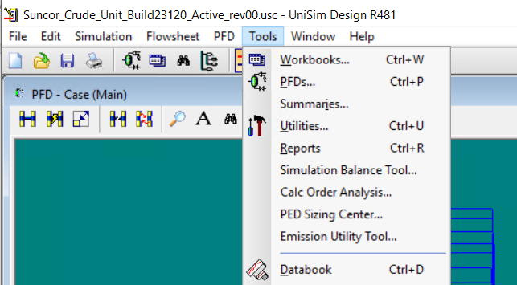
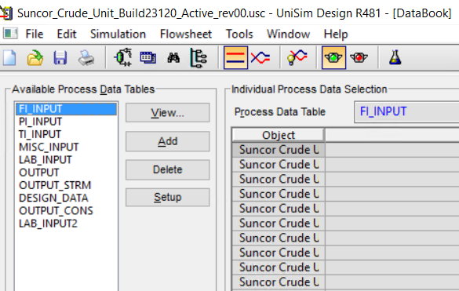
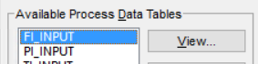
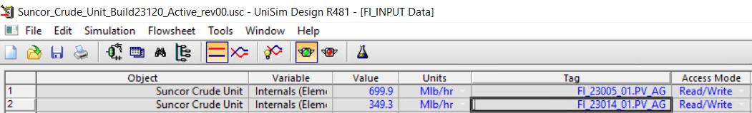
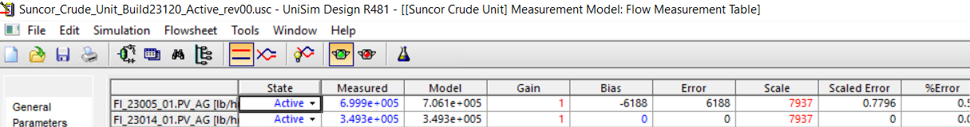
Unisim simulation-getting plant data into the model
DATABOOK
LIST PDT TABLES INSIDE DATABOOK
PDT TABLE FOR FLOW
DATA FLOW FOR INPUT FLOW TAG NO-”FI_23014_01.PV_AG”
INSIDE FLOW PDT TABLE
FLOW MEASUREMENT TABLE

Slide 27
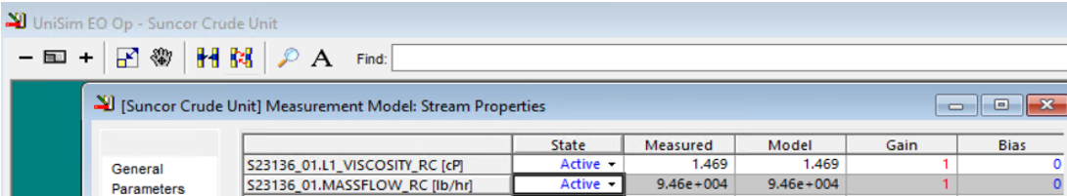
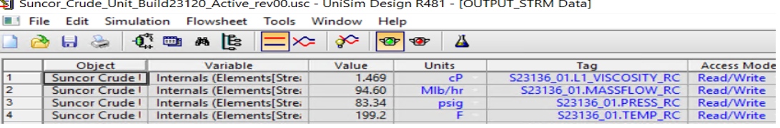
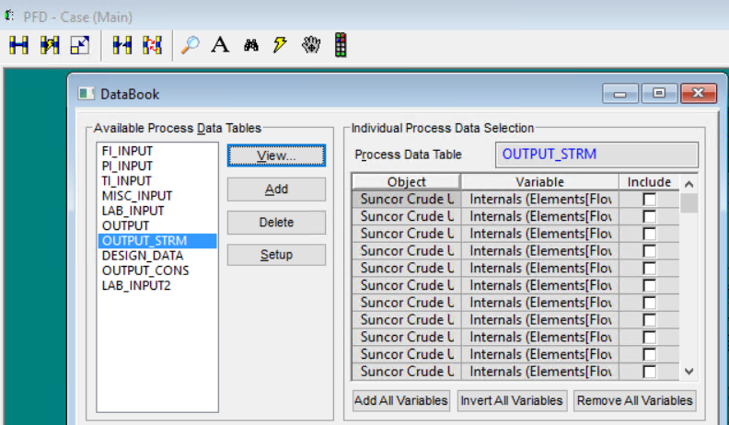
UniSim Simulation – extraction of results
OUTPUT MEASUREMENT TABLE
“OUTPUT_STRM” PDT TABLE
LIST OF PDT TABLE IN DATABOOK
DATA FLOW FOR OUTPUT TAG NO-”S23136_01.MASSFLOW_RC” FROM MODEL TO OUTPUT CSV FILE
OUTPUT CSV FILE

Slide 28
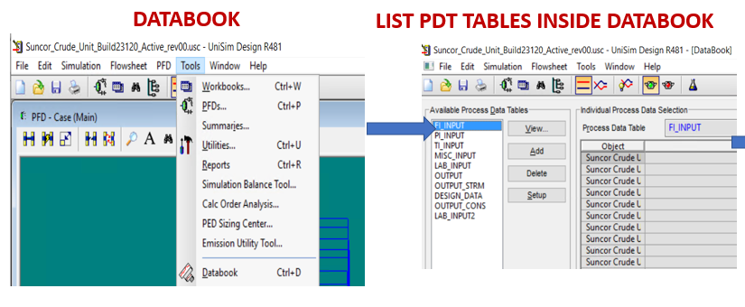
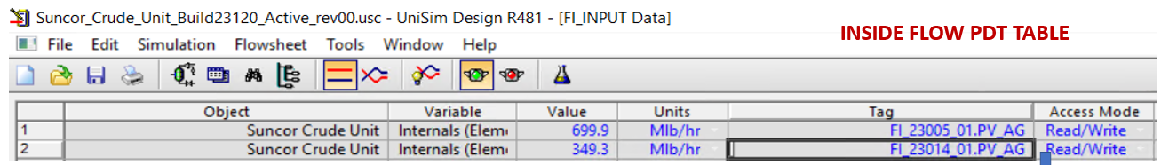
DATABOOK AND PDT TABLES- Contains Multiple Pdt Table For Output And Input Values Of Unisim And The Only Connection Between Unisim And Cloud.
INPUT PDT TABLE (FLOW, PRESSURE, TEMPERATURE, LAB, MISCELLANEOUS) – Connects The Input CSV File Values To Input Measurement Tables((Flow, Pressure, Temperature, Lab, Miscellaneous)

Slide 29
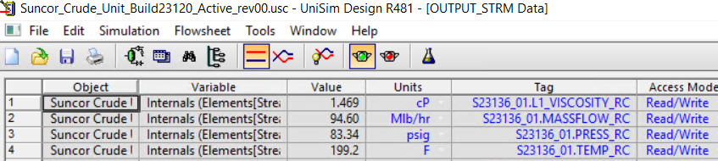
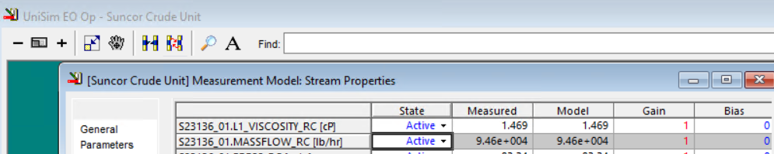
OUTPUT PDT TABLES – Located In Databook And It Connects The Output Measurement Table Values To Output Csv File In Cloud
OUTPUT MEASUREMENT TABLES-Takes Input From The Model Values And Connects With The Output Pdt Tables In Databook

Slide 30
Orchestration step-2 (Solve and write)
Increment Schedule for next Run
Kill Unisim Process if KeepProcess False
Run Solver
Generation of Output Snapshot .csv & .usp
Fetching of the Values Input Values for USD Input PDT
Scheduling of the Orchestration Service
Ready Check
Generation of Input Snapshot .csv & .usp
e-PHD
Orchestration Service
UniSim
Frequency of Orchestration Service is 60 min

Slide 31
ORCHESTRATION
Pre-Conditions for triggering Orchestration
A
B
c
Input CSV & USP File
Output CSV & USP File
Frequency of Execution-60 min
Frequency of Orchestration Service is 60 min

Slide 32
Overall orchestration flow
Increment Schedule for next Run
Kill Unisim Process if KeepProcess False
Run Solver
Generation of Output Snapshot .csv & .usp
Fetching of the Values Input Values for USD Input PDT
Scheduling of the Orchestration Service
Ready Check
Generation of Input Snapshot .csv & .usp
e-PHD
Orchestration Service
UniSim
Frequency of Orchestration Service is 60 min

Slide 33
Selected results written back to TSDB
e-PHD
CHC
TSDB
Unisim Output Tags
MR Output Tags
Calc Tags
Internal Cloud Collector
e-PHD tags added to cloud collector
TSDB has access to Tags added to CHC
Dashboard refers Tags from TSDB

Slide 34
Connection to dashboards
Time Series Data Base (TSDB)
Visualization configuration Mapping
Dashboards

